Slide 1
Expert Team on Climate Change Detection and Indices (ETCCDI)
www.ec.gc.ca
CLIVAR SSG-18
Xuebin Zhang
Climate Research Division
Science and Technology Branch
Albert Klein Tank
KNMI

Slide 2
Outline
ETCCDI in brief
Collaboration with other groups
ETCCDI indices
Regional workshops
Status of detection and attribution work
Future of the Panel / Expert Team
Key challenges

Slide 3
ETCCDI: Anthropogenic, extremes
Expert Team on Climate Change Detection and Indices
Jointly sponsored by CCl, CLIVAR and JCOMM
Current term started in May 2010
13 members (6 new members)
CLIVAR’s 4 members for 2 years
CCl and JCOMM each has 4 members for next 4yr
One member from GEWEX
Co-chairs:
Xuebin Zhang (CLIVAR), Environment Canada
Albert Klein Tank (CCl), KNMI

Slide 4
Collaboration with others
IDAG: International ad-hoc Detection and Attribution Group
CCl Expert Team/task forces on climate monitoring, data rescue, sector specific indices (water resources and agriculture)
JCOMM, position paper on marine indices, extension of land indices to ocean
GEWEX, extremes in precipitation, drought
But link to WCRP extreme cross-cut unclear (input was given to cross-cut but no follow up yet)

Slide 5
Role of indices of extremes
ETCCDI approach for monitoring changes in extremes is based on internationally coordinated set of climate indices
Indices are simple, straight forward, reliable, and consistent descriptions of extremes which include frequency, amplitude and persistence
Can be used for both observations and models, globally as well as regionally (supported software available in R and Fortran)
Can be coupled with
simple trend analysis techniques
standard detection and attribution methods
more advanced methods specifically developed for extremes
Recent review suggests modification to some indices

Slide 6
Indices website: http://cccma.seos.uvic.ca/ETCCDMI
Station indices data, software for indices calculation and data homogeneity assessment available
There are About 1000 registered users
Gridded indices available as HadEX

Slide 7
Regional workshops
Organized together with the Asian Pacific Network (APN)
Practice and goals:
Free software + hands-on training + post workshop follow-ups
build capacity to analyze observed changes in extremes
improve information services on extremes
publish peer-reviewed papers from each workshop
contribute to worldwide database of derived indices
Workshop papers done in time for TAR, AR4 and SREX, and perhaps AR5 as well
ET website keeps record of all past workshops

Slide 8
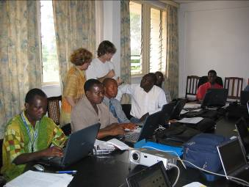
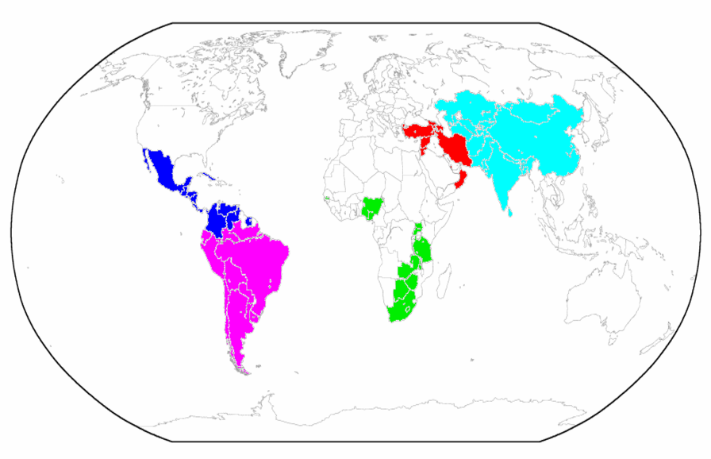
WMO ETCCDI Workshops 2002-2010 (complemented by APN)
Working together
GHAfrica Workshop
(WMO/World Bank)
04/2010
Central Africa (USA) 04/2007
Mexico (UK)
03/2009
Southeast Asia (USA)12/2007
West Indian
Ocean (France)
09/2009
Indonesia, Malaysia,
Thailand, Philippines
(NL) 12/2009
Peterson and Manton, BAMS, 2008

Slide 9
Planned regional workshops 2011-2012
US funded (still unclear but we might be able to do one)
Kingston, Jamaica (US funding)
Casablanca, Morocco (US funding)
Niamey, Niger (WMO funding)

Slide 10
Detection and attribution
Closely linked with IDAG
Stott et al. 2010 WIREs review
New detection work still based on CMIP3 models
Extreme precipitation (Min et al. 2011 NH, Pall et al. 2011 event attribution)
Extreme temperature (Zwiers et al. 2011, global and regional)
Anticipate large influx of CMIP5 based d&a papers and near-term prediction

Slide 11
Current ETCCDI Work plan
Updating HadEX
Supported by ARC Linkage project (UNSW, Had, NCDC, EC)
Station indices and different gridded products
Interactive webinterface
Deriving indices from model simulations
Computation for CMIP3 models done
Computation for CMIP5 models underway
Indices will be available through PCMDI/CCCma
Description/model validation papers being drafted
Maintain/improve software and other tools
Review paper on ET indices ready for submission to WIREs

Slide 12
Current ETCCDI Work plan
Continue to host regional workshops, work with IDAG on detection and attribution
Work closely with CCl ET on sector indices to better support adaptation
Increase involvement of expert statisticians in formulating questions on extremes (e.g. use of spatial information)
Contribute to IPCC SREX and AR5 (indices data and analyses, IPCC report authorship)
Anticipate more than one effort to assemble near global datasets of observed indices
Anticipate many diagnostic studies based on indices and CMIP5 simulations, which will have WG1 and WG2 relevance
ET is involved in planning the upcoming WCRP OSC

Slide 13
Key challenges (1 of 2)
Current ETCCDI term started last May
SSG-17 gave 2-yr term for CLIVAR members, but CCl and JCOMM members have 4-yr term. We request SSG to extend for additional 2-yr for current members to avoid interruption
Manage expectations: small team, limited capacity
Keep the team focused, as well as open for new directions
Positioned to develop broadened indices
Heat wave related indices (Blair Treiw)
Drought indices: (Aiguo Dai working on this)
Marine indices (JCOMM members to produce a position paper)
More coordination with other panels including WCRP Cross-Cut on Extremes?

Slide 14
Key challenges (2 of 2)
Data issue:
Many daily data not openly exchanged
Models may not adquelty simulate extreme
There is a scale mismatch between station data and model data
Detection and attribution
Still low s/n for most extremes (daily temperature is an exception) to detect external influence
Event attribution in operational model
Prediction for near-term (10-20 yr) and projection for long-term (50+yr) of extremes
Engineering applications of non-stationary in extreme
Understanding processes generating extremes

