Slide 1
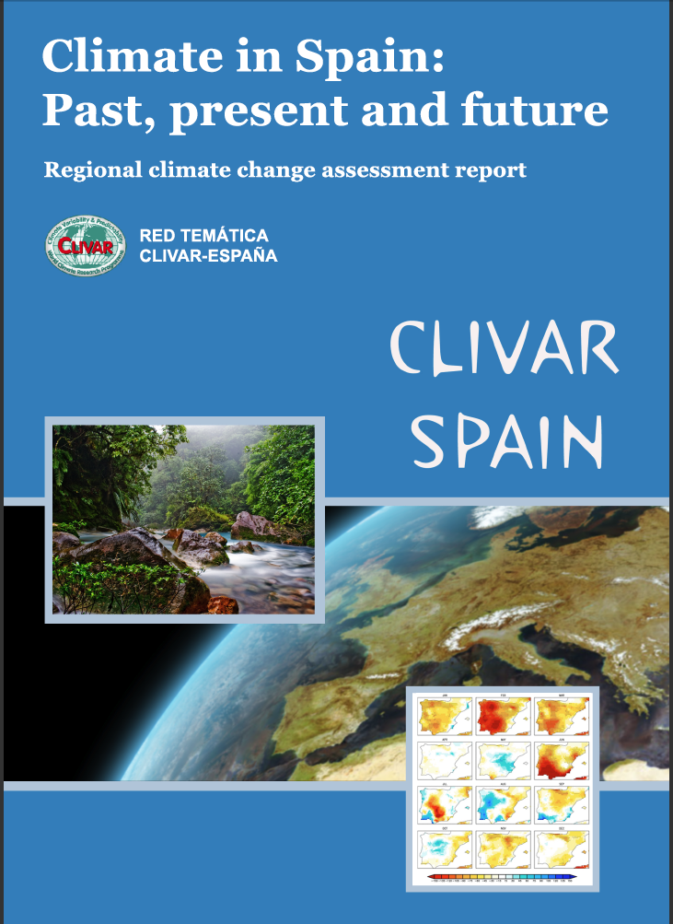
Climate in Spain: Past, present and future
CLIVAR-SPAIN
Regional Climate Change
Assessment Report
Editors:
Fiz F. Pérez (IIM-CSIC)
Roberta Boscolo(WMO-WCRP)
Authors: CLIVAR-SPAIN thematic network
http://clivar.iim.csic.es
http://www.clivar.org/organization/national.php, http://www.wcrp-climate.org)

Slide 2
CLIVAR-SPAIN NATIONAL COMMITTEE/THEMATIC NETWORK
HISTORY: exists since 2003
COMPOSITION: More than 100 Spanish researchers
GOALS:
Promote and coordinate climate research in Spain related to CLIVAR objectives
Improve quality and relevance of Spanish science
Foster collaboration between scientific groups
Lobby” for public access to Spanish meteorological/climate data
Increase the international visibility of Spanish climate research
Encourage the participation of Spanish scientists in international conferences and their involvement in international scientific committees and organizations.
Communicate the relevance of Spanish climate science to the media and socio-economic milieus
PUBLICATIONS:
Report “The State of the Art of the Spanish Contribution to the CLIVAR Program ” (2006)
Report “Climate in Spain: Past, Present and Future” (2010)
CLIMATE IN SPAIN: PAST, PRESENT AND FUTURE

Slide 3
CLIVAR-SPAIN
Need for a regional climate assessment report
IPCC reports need to be complemented with climate reports at a regional level that assess the scientific knowledge of climate change in particular regions of the world.
In the AR4 IPCC report, southern Europe is signaled as an area particularly vulnerable to climate changes
Characteristics of Iberian Peninsula enhace this vulnerability: hydrological deficit + societal dependence on water + fragility of Mediterranean ecosystems
GOALS OF REGIONAL REPORT
Document the observed robust physical changes (past and present) in Iberia
Compare recent observed changes (trends) with model projections
Assess our understanding of the physical processes associated with natural climate variability on all time scales
Discuss and validate projections from regional climate models
CLIMATE IN SPAIN: PAST, PRESENT AND FUTURE

Slide 4
CLIVAR-SPAIB
Report “Climate in Spain: Past, Present and Future”
Chapter 1: “Review of paleoclimate reconstructions in the Iberian Peninsula since the last glacial period”
Isabel Cacho, Blas Valero Garcés, Penélope González Sampériz and 23 co-authors
Chapter 2: “Atmospheric trends in the Iberian Peninsula during the instrumental period in the context of natural variability”
Ileana Bladé, Yolanda Castro-Díez and 28 co-authors
Chapter 3: “Ocean Variability and sea level changes around the Iberian Peninsula”
Manuel Vargas-Yáñez, Marcos García Sotillo, Damiá Gomis and 27 co-authors
Chapter 4: “Climate teleconnections affecting Iberian Peninsula climate variability: Predictability and expected changes”
Belén Rodríguez-Fonseca, Concepción Rodríguez-Puebla and 40 co-authors
Chapter 5: “Regional climate projections over the Iberian Peninsula: climate change scenarios modeling”
Enrique Sánchez, Gonzalo Miguez-Macho and 9 co-authors

Slide 5
CLIVAR-SPAIN
Report “Climate in Spain: Past, Present and Future”
Synthesis report + working document (future updates planned)
Regional report, complementary to IPCC reports
Open collaborative effort (all groups in the climate field were invited to participate, 120 authors)
External peer review
Based on “real” science (all reference material based on SCI papers)
Critically assesses and discusses information
Provides specific and rigorous conclusions
CLIMATE IN SPAIN: PAST, PRESENT AND FUTURE

Slide 6
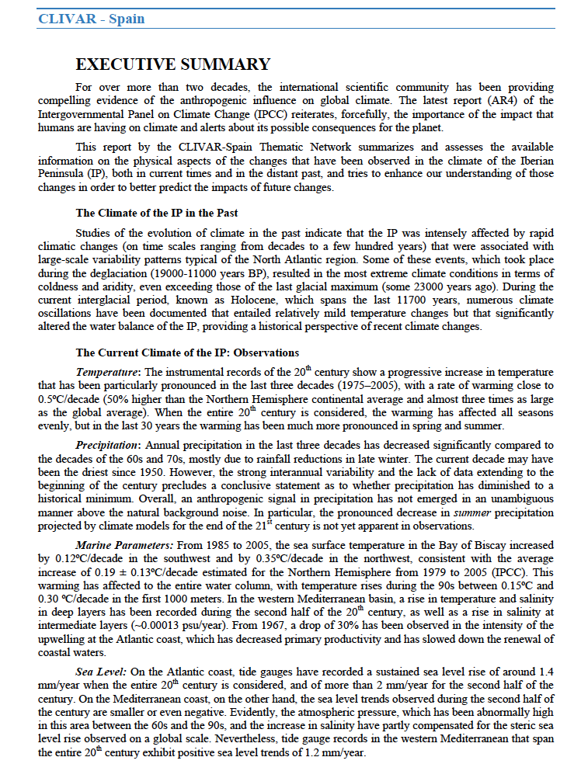
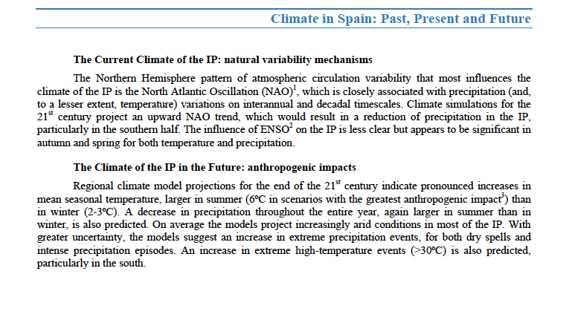
http://clivar.iim.csic.es
http://http://www.clivar.org/organization/national.php
http://www.wcrp-climate.org)
CLIMATE IN SPAIN: PAST, PRESENT AND FUTURE

Slide 7
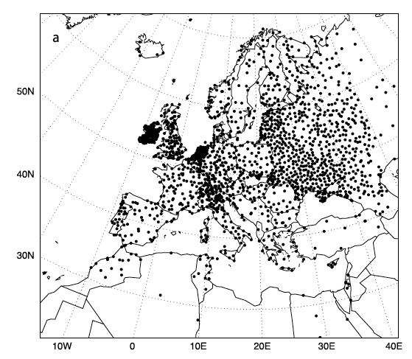
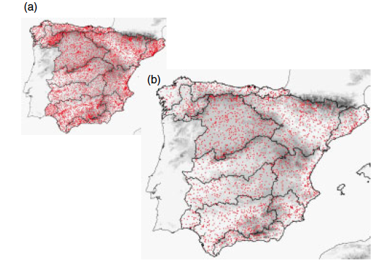
Available Spanish Precipitation stations
(E-OBS dataset)
Actual network of precipitation stations

Slide 8
Cluster-poster – Climate Variability and Change in the Southwest Mediterranean
(CLIVAR-SPAIN contributions): 35 posters.

